Slide 1
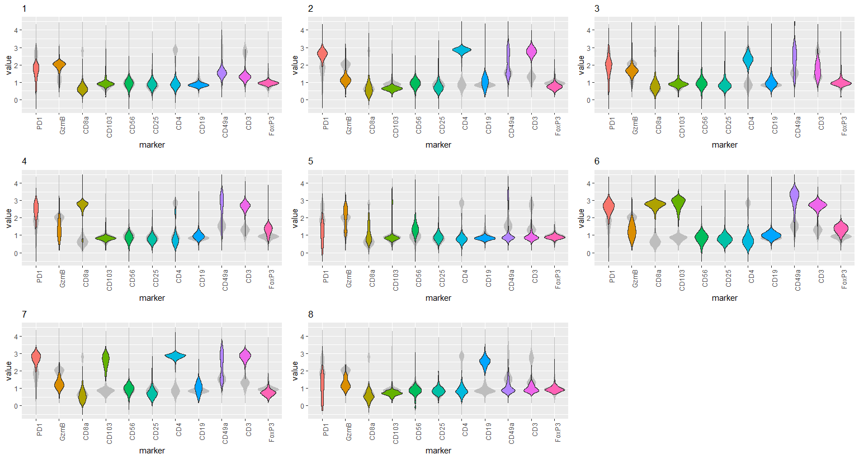
Notes:
ccRCC_652T_Tcells 8

Slide 2
